Slide 1
Blockchain & Legal Innovation I Lecture 4 – Digital Assets

Slide 2
Assessment 1
I mark this assessment leniently. Focus is on ensuring you understand underlying “mental model”
Keep it short – only 20mins. 10 slides, maybe…
Focus on what is unique/challenging about blockchain

Slide 3
Basic Structure
I will look at <issue/topic>.
The issue arises because <link between topic and technology>.
These are the traditional legal principles <show you understand the law>.
The application to blockchain is difficult because <show you can map traditional rules to the novel technology>.
Here is my proposal/solution/next steps <where the high marks are, original thinking that is a synthesis of technology and law>

Slide 4
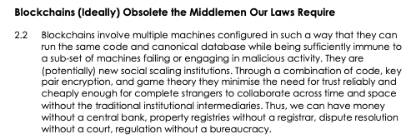
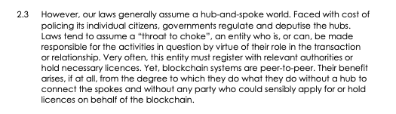
In a Nutshell…

Slide 5
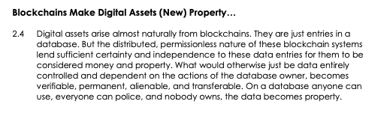
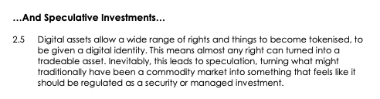
In a Nutshell…

Slide 6
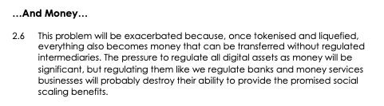
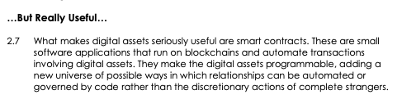
In a Nutshell…

Slide 7
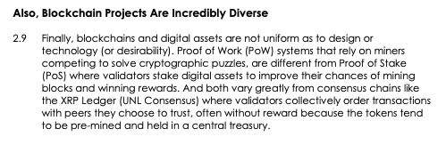
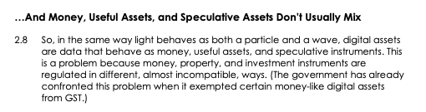
In a Nutshell…

Slide 8
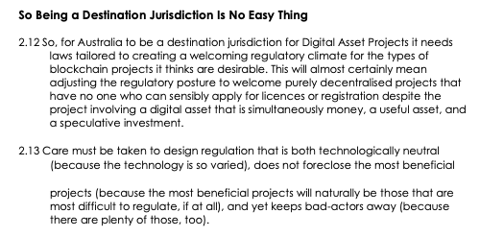
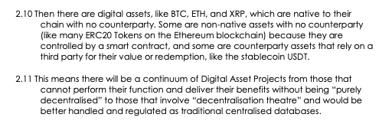
In a Nutshell…

Slide 9
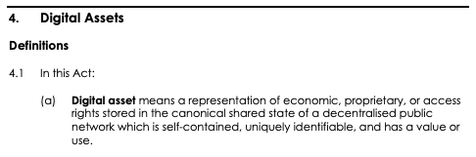
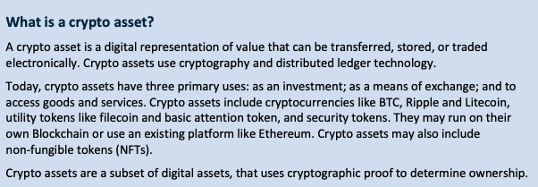
What are digital assets
View 1
View 2

Slide 10
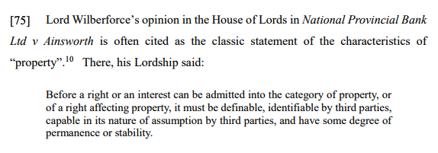
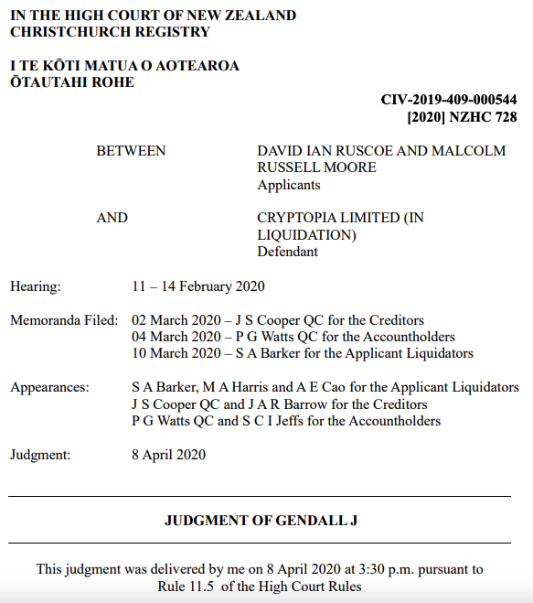
Are Digital Assets Property?
Information
Property
Are the records assets?: Information is not usually property, but the law is very flexible.( https://www.alrc.gov.au/publication/definitions-of-property/)
What are the private keys assets?:
Significant that case law (such as Quoine) mostly deals with Exchanges.
Significant in Australia for purpose of determining whether (and if so what) security interest can be registered over a digital asset under the Personal Property Securities Act. (https://www.ppsr.gov.au/ppsr-overview)

Slide 11
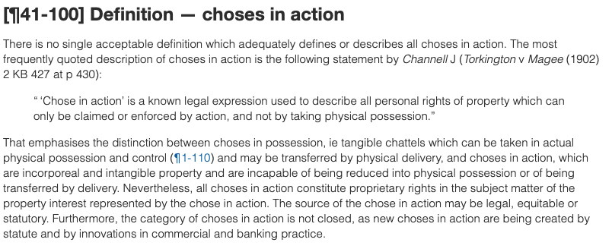
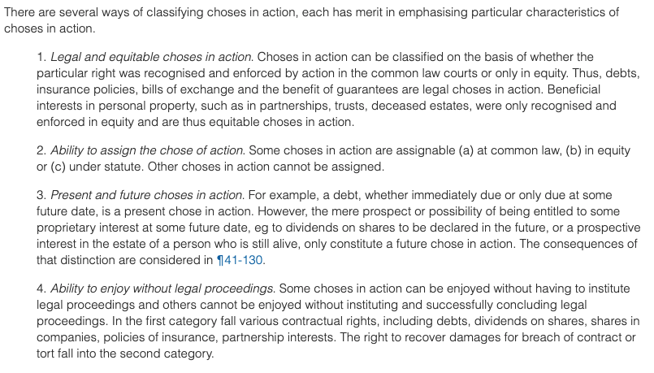
What Type of Property
Possession v Action
Chose in Possession

Slide 12
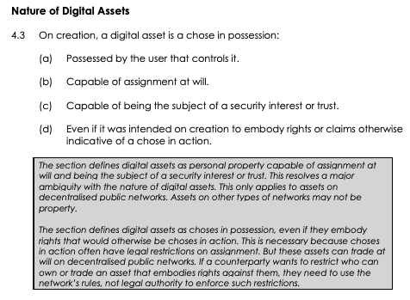
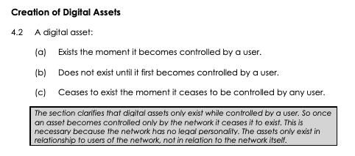
Proposal
Creation
Nature

Slide 13
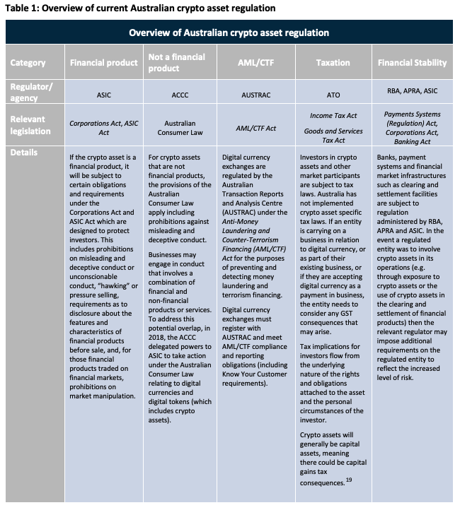
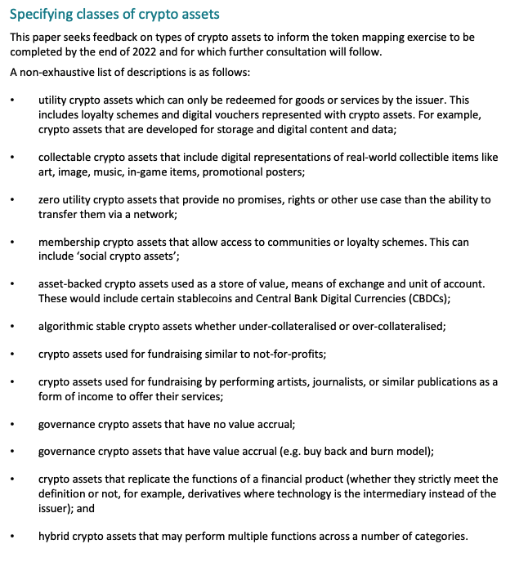
Types of Digital Assets
View 1
View 2

Slide 14
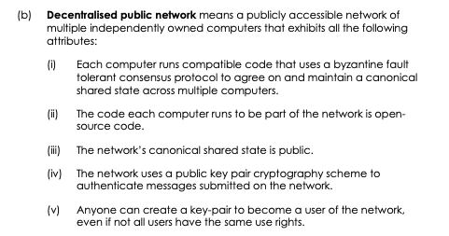
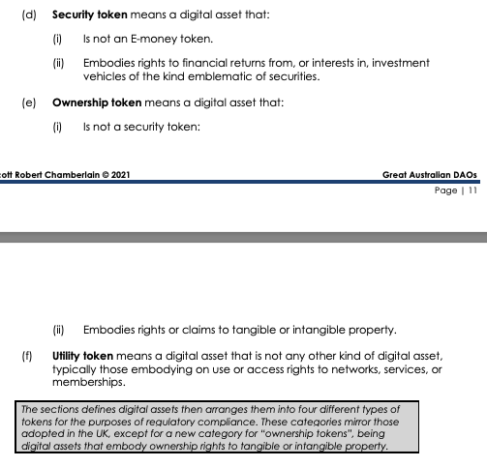
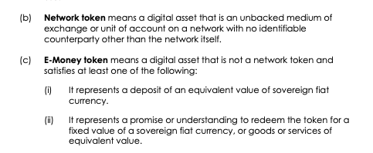
Suggested Definitions

Slide 15
Native vs Non-Native
Native – BTC ETH XRP
Non-Native – ERC-20
Created by the rules of the protocol that runs the chain/ledger.
Have more “asset-ness”: no counterparty
Have more “money-ness”: they “are what they are” and so can function more like money.
Exist because someone has “put them on” a chain.
Have a counter-party: more likely to be a security.
More Likely Good or Service: attract consumer protection laws – misleading and deceptive conduct, statutory warranties etc

Slide 16
Fungible vs Non-Fungible
Fungible – BTC ETH XRP
Non-Fungible - NFTs
Each asset is indistinguishable
More like money
Each asset is unique
More like rights

Slide 17
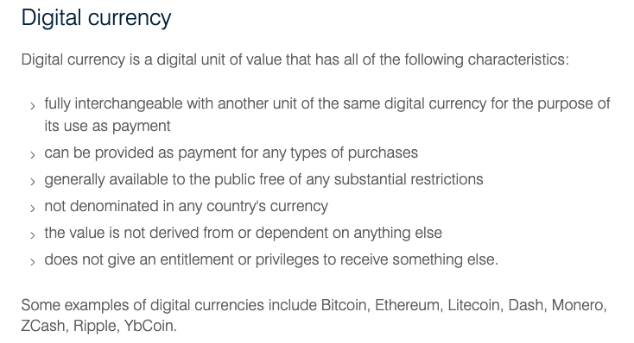
Tokens as Money/Currency
Definition
Types
Native Tokens
Fiat-Backed Stablecoins
Algo-stablecoins
Issues
Application of AML/KYC Laws
Application of Payment Services Laws:
Exemption from GST
Fungibility and right to good title

Slide 18
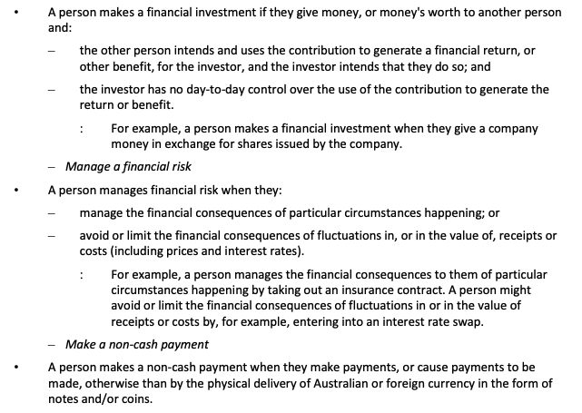
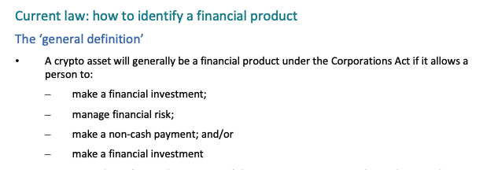
Tokens as Financial Products
Basic Definition
Detail Considerations

Slide 19
What About Something Else
NFTs – arts and rights
Property
Identity
Membership
Governance
Use and Access rights

Slide 20
Money vs Something Else
The Lien Problem: https://ftalphaville.ft.com/2015/03/24/2122678/bitcoins-lien-problem/
If an asset is actually money, bona fide purchasers generally acquire good title.
If an asset is a good or chattel that is treated like money, a lien generally exists in favour of rightful owner.
If an asset is intangible property that is treated like money, equity might still grant remedies approaching ownership.

Slide 21
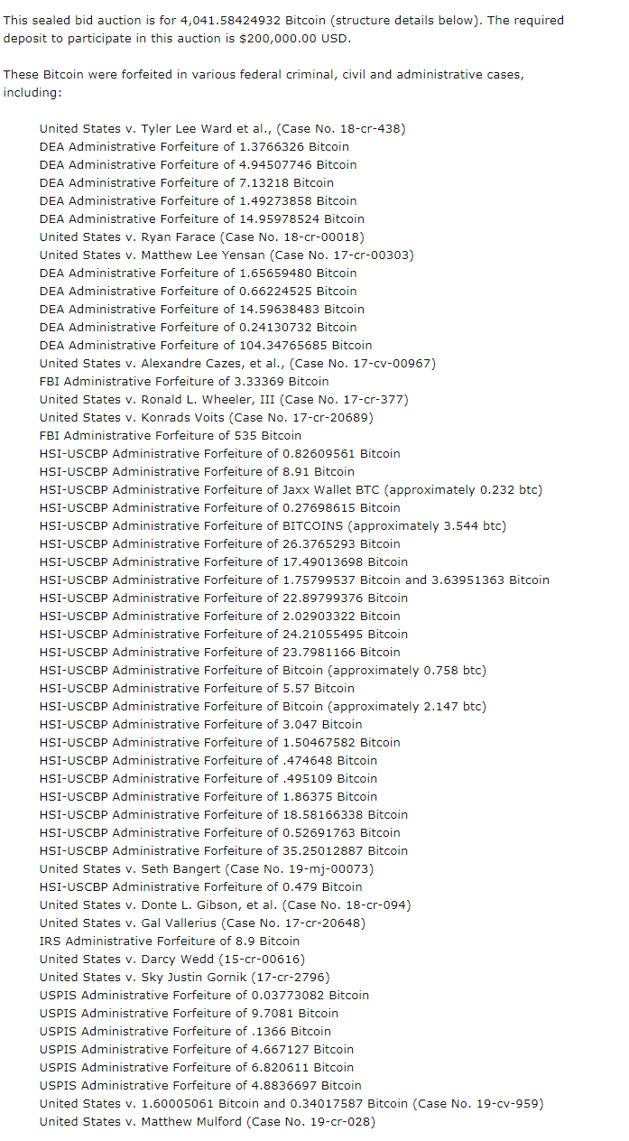
Digital Money is easy to trace…
This is a recent list of BTC being auctioned by US Govt because it has been seized from criminals or people who failed to pay tax.
Interestingly, this BTC, like BTC purchased direct from miners potentially has a premium value because it is “clean”…

Slide 22
Good Issues For Research
Can fraudulently acquired digital assets be traced and recovered via lien?
To what extent does the public nature of blockchain negate “bona fide third party for value without notice” defences to restitution?
To what extent are exchanges obliged to confirm the valid chain of title of assets they receive and so not cash out ill-gotten digital assets?

Slide 23
Good Issues For Research
Does loss of private keys constitute disposal of an asset for CGT purposes? Does sharing private keys constitute disposal of an asset for CGT purposes?
What category of personal property is a digital asset for the purposes of the Personal Properties Security Register?
Could a registered personal properties security interest be enforced in any meaningful way?

Slide 24
Good Issues For Research
Are digital assets property? Are private keys property?
Does stamp duty apply to sale of digital assets that represent interests in real estate?
Choose a particular digital asset. Is it a good, service, or intangible property, or nothing at all? Does GST apply to its transfer? Does capital gains tax apply to its disposal?

Slide 25
Good Issues For Research
Assume a client has had their bitcoin stolen. They are able to trace their bitcoin to from the thief’s address to Binance where it was sold for $AUD which was then withdrawn. What options exist for the client to retrieve their stolen bitcoin? Can they even show anything was stolen? Does it matter whether their coins were stolen through:
A hack involving a vulnerability in their hardware wallet?
The theft of their private keys?

